Slide 1
Shell & pThreads
David Tatis Posada

Slide 2
Shell
In computing, a shell is a user interface for access to an operating system's services.
Command line interface
Graphical interface

Slide 3
CLI Shells
A command-line interface (CLI) is an operating system shell that uses alphanumeric characters typed on a keyboard to provide instructions and data to the operating system

Slide 4
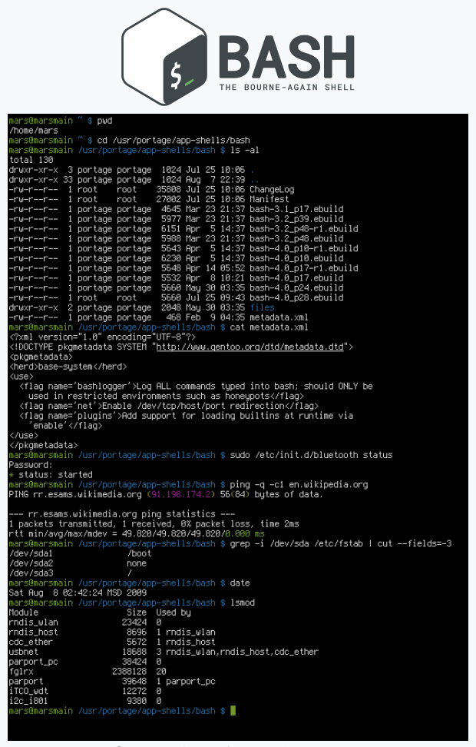
Bash
GNU Bash or simply Bash is a Unix shell and command language written by Brian Fox for the GNU Project as a free software replacement for the Bourne shell.

Slide 7
pThread
Exists within a process and uses the process resources
Has its own independent flow of control as long as its parent process exists and the OS supports it
Duplicates only the essential resources it needs to be independently schedulable
May share the process resources with other threads that act equally independently (and dependently)
Dies if the parent process dies - or something similar
Is "lightweight" because most of the overhead has already been accomplished through the creation of its process.

Slide 8
pThread vs frok
The primary motivation for using Pthreads is to realize potential program performance gains
Managing threads requires fewer system resources than managing processes.
Process has resource ownership: Virtual address space to hold process image including program, data, stack and attributes.

Slide 9
pThread
#include <pthread.h>
int pthread_create(pthread_t *thread, const pthread_attr_t *attr, void *(*start_routine) (void *), void *arg);
Compile and link with -pthread.
http://man7.org/linux/man-pages/man3/pthread_create.3.html

